Slide 1

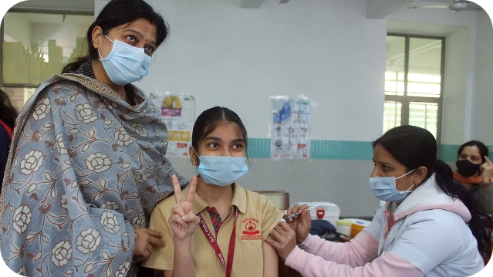

A Modern Approach to Polio Vaccination in India
India has made significant progress in eradicating polio. This presentation outlines a new strategy that uses technology to improve the vaccination process and ensure every child receives the necessary protection.
by Khan

Slide 2

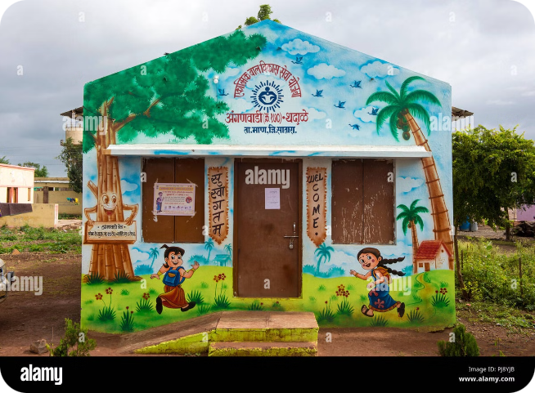
The Existing System: Challenges and Gaps
1
Accessibility
Parents need to travel to anganwadis or clinics, which can be difficult, especially in remote areas.
2
Timeliness
Long queues and limited staff can lead to delays in vaccination, impacting the child's health.
3
Awareness
Many individuals lack knowledge about polio, its importance, and the vaccination process.
4
Record Keeping
Managing paper-based mother and child cards is cumbersome and prone to errors.

Slide 3
A Digital Solution: User-Friendly Website
Data Access
AI Voice Bot
Real-Time Tracking
The website utilizes hospital data, like birth certificates, to access child information and vaccination records.
An AI Voice Bot automatically calls parents to inform them about upcoming vaccination schedules, ensuring timely reminders.
Parents can use the website to track their child's vaccination status, providing them with valuable information.

Slide 4





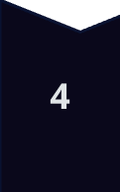
Empowering Parents: Knowledge & Convenience
Website Information
The website provides detailed information about polio, its symptoms, and the importance of vaccination.
Weekly/Monthly Meetings
Regular meetings at anganwadis are held to educate parents and address their concerns about polio.
Home Vaccination
Nurses visit homes to administer vaccines, ensuring accessibility and convenience for parents.
Out-of-Station Support
Parents traveling outside their area can visit the nearest anganwadi to get their child vaccinated.

Slide 5






AI Voice Bot: A Game Changer
Personalized Reminders
The AI Bot calls parents three days and one day prior to the scheduled vaccination, ensuring they remember the appointment.
Multilingual Support
The Bot can communicate in multiple languages, ensuring effective communication with parents in various regions.
Flexible Scheduling
Parents can adjust their child's vaccination schedules through the website, making the process more convenient.
Vaccination Information
The Bot provides detailed information about the vaccination process, addressing any queries parents may have.

Slide 6


Benefits of the Digital Solution
Increased Vaccination Coverage
The digital system ensures more children receive timely vaccinations, contributing to a healthier population.
Reduced Burden on Healthcare Workers
The AI Bot and website reduce the workload on healthcare workers, enabling them to focus on critical tasks.
Empowered Communities
The digital platform promotes community engagement and empowers parents to take an active role in their child's health.
Efficient Resource Allocation
The system helps in optimizing resource allocation by providing real-time data and insights into vaccination needs.

Slide 7


Data Security and Privacy
Data Encryption
All data is encrypted to ensure confidentiality and prevent unauthorized access.
Access Control
Strict access control measures are implemented to protect sensitive information.
Regular Audits
Regular audits are conducted to ensure compliance with data security protocols.
Privacy Policy
A comprehensive privacy policy outlines how data is collected, used, and protected.

Slide 8

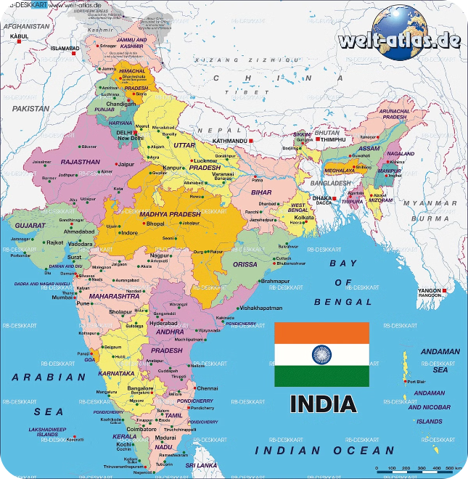
Implementation Plan: A Phased Approach
1
Pilot Phase
The digital system will be piloted in select districts to evaluate its effectiveness and gather feedback.
2
Scaling Up
Based on the pilot results, the system will be gradually rolled out to other districts across India.
3
Continuous Monitoring and Improvement
Regular monitoring and analysis of data will inform ongoing improvements and optimization of the system.

Slide 9


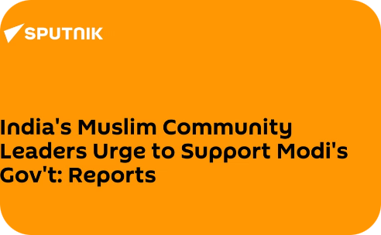
Partnerships and Collaboration
Healthcare Professionals
Government Officials
Community Leaders
Close collaboration with doctors, nurses, and other healthcare professionals is essential for successful implementation.
Government officials will play a crucial role in supporting the initiative and promoting its adoption.
Engaging community leaders will facilitate awareness and encourage parents to embrace the new system.

Slide 10


Towards a Polio-Free India
This innovative approach will help India achieve its goal of eliminating polio. By combining technology, community engagement, and efficient healthcare practices, we can create a brighter and healthier future for every child in India.

